Slide 1

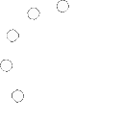
MINI
QuakerOS

Slide 3


Hi! User

Slide 4

Hi! User

Slide 5


Hi! User

Slide 6
Hi! User
Welcome

Slide 7




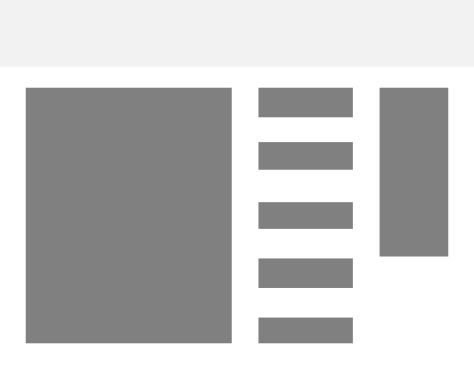
Search in Bing…
WebSites
Apps
Shutdown

Slide 8









Apps
QuakerMedia
QuakerWord
QuakerBrowser
QuakerMedia
QuakerWord
Technical support
About the system
QuakerAntiVirus

Slide 9

Shutdown and Restart
Shutdown
Restart

Slide 11




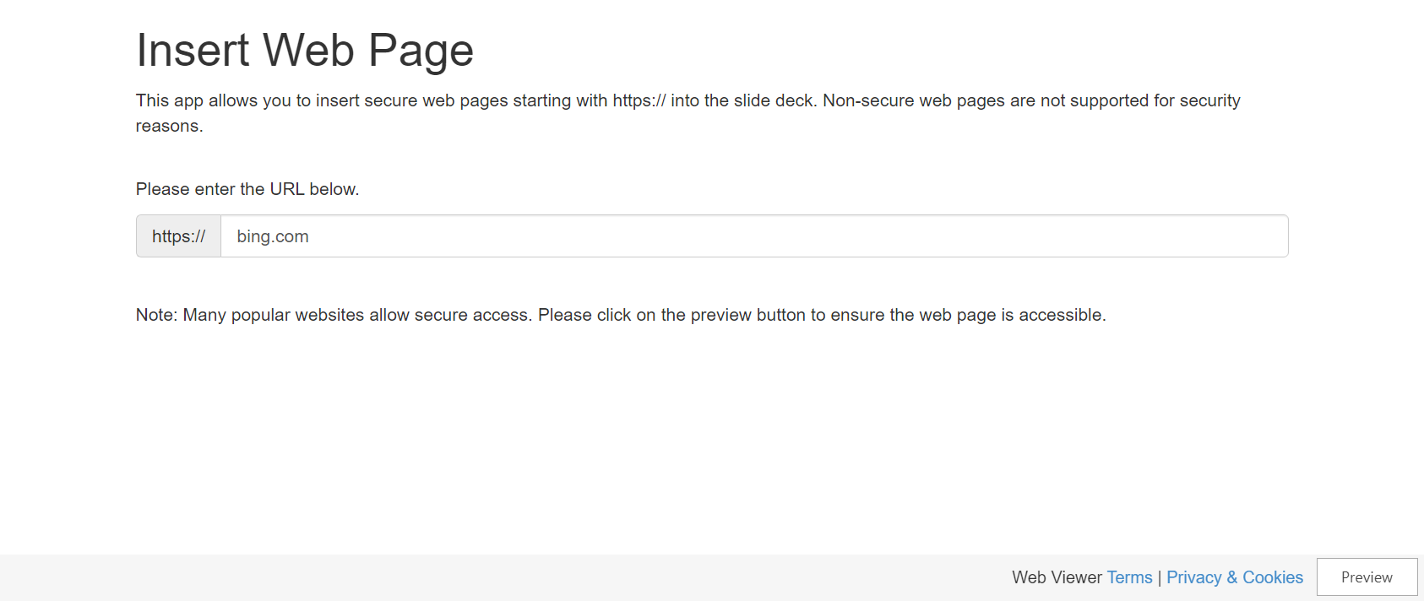
https://www.randomwebsite.com/

Slide 12


Slide 13




Photo
Videos and movies
Music
100

Slide 14

Now...
100

Slide 15
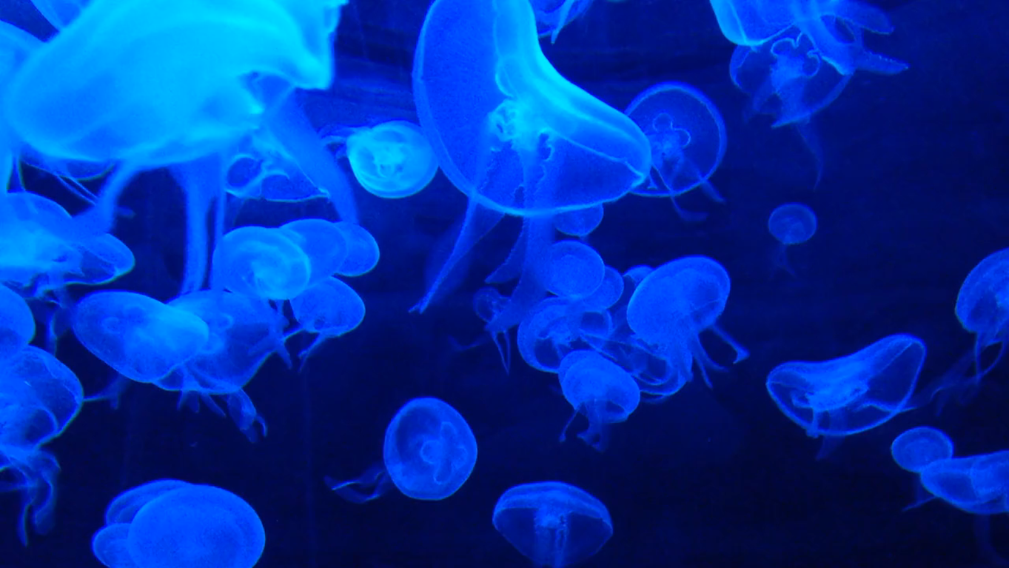
Photo
Videos and movies
Music
100

Slide 16

Jellyfish
100

Slide 17

Photo
Videos and movies
Music
100

Slide 18

Closed
Auwdio
100

Slide 19
QuakerWord

Slide 20


Documents
________________ ________________
________________ ________________
________________ ________________
________________ ________________
About the program

Slide 21

Documents
About the program
®
QuakerWord Mini
Version: 4.3.7878.46767 (QuakerOSMINI_rtm.273833-4649) with QuakerWord technologies Copyright © 2022 QuakerSoft. This product is licensed under the terms of the End User License Agreement.

Slide 22
Closed

Slide 23

Closed

Slide 25
Antivirus
Scanning
Scan Verification
About the program
?
System
?
Browser
?
Apps
If you have an arrow, then immediately delete the files by clicking on the "delete" button!
?
Why do I need a system scan? It is needed to check the computer for viruses, manners and other types!

Slide 26
Antivirus
Scanning…
Scan Verification
About the program
?
System
?
Browser
?
Apps
If you have an arrow, then immediately delete the files by clicking on the "delete" button!
?
Why do I need a system scan? It is needed to check the computer for viruses, manners and other types!

Slide 27

Antivirus
Scanning
Scan Verification
About the program
System
Browser
Apps
If you have an arrow, then immediately delete the files by clicking on the "delete" button!
?
Why do I need a system scan? It is needed to check the computer for viruses, manners and other types!

Slide 28
Antivirus
QuakerAntiVirus
About the program
®
QuakerAntiVirus Mini
Version: 4.3.7622.78524 (QuakerOSMINI_rtm.273833-4649) with QuakerAntiVirus technologies Copyright © 2022 QuakerSoft. This product is licensed under the terms of the End User License Agreement.

Slide 30
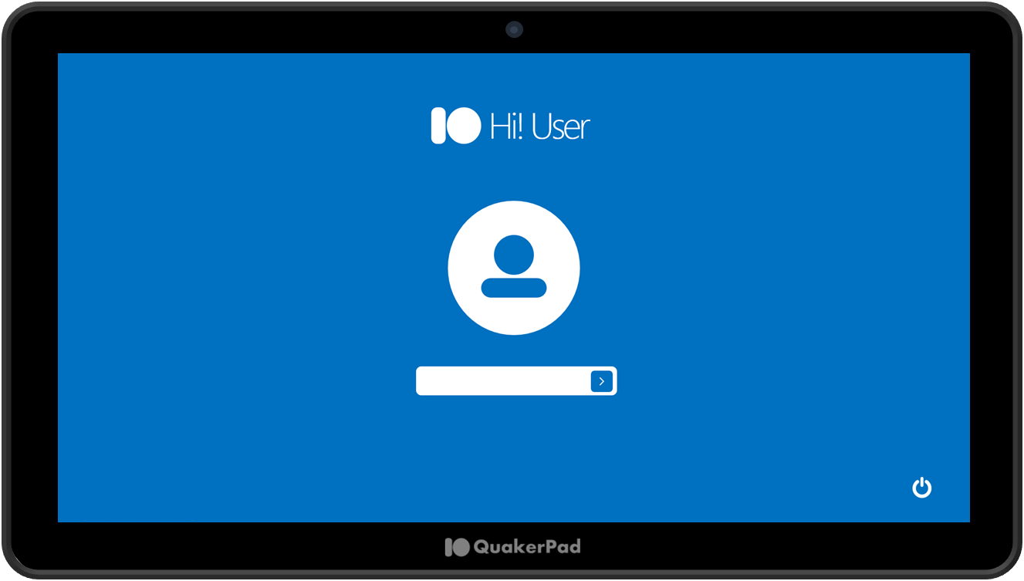
System Information
Installed Memory (RAM): available 8 GB (7.88 GB)
System Type: 64-bit
Pen and touch input: Supported
Device and Model: QuakerPad 2qua
Who did

Slide 31

System Information
Did Leo_#5653 (Director and Designer)
Who did

Slide 33
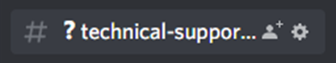
How to ask for help?
To contact technical support, you need to go to the discord server (https://discord.gg/QhaXNrxr5A) or write Leo_#5653 then we will help you

Slide 34
Restart

Slide 35
Shutdown

